Slide 1
What is the purpose of an engineer, i.e. what does an engineer do and why?
How is a biological/food process/pharmaceutical engineer different than a biologist/food scientist/pharmacist?
What is different in the education/skills learned by an engineer vs. a scientist, e.g. what are curriculum differences?
In the workplace, what do engineers do that is different than scientists?

Slide 2
What is the value of an engineer?
In today’s globally competitive, internet connected world, information/knowledge is cheap/free. You can look up facts, equations, and data without a college engineering education. Engineering graduates from any school around the world can easily use pre-programmed computers to calculate mass/energy balance equations, compute unsteady state dynamic fluid flow, or thermal gradients in heat exchangers. (all that calculations homework stuff you do in classes)
So what makes you (Purdue ABE engineering graduate) worth more than your global competitors from China or India (whom are paid less)? What make you more valuable/puts you at a competitive advantage?

Slide 3
Rate of Technological Change
How quickly do new apps/cell phones/food products appear?
With the rapid rate of technological changes in modern engineering, how long would using a trained skill be valuable (e.g. knowing how to use facebook, operate windows 7, use an iPod?
How long should an engineering college education last? What should be taught that might have long term value rather than short term value?

Slide 4
Knowledge Bases expected
Sciences
Chemistry
Physics
Biology
Mathematics
Algebra, Calculus, Geometry
Differential Equations Initial value/ Boundary value
Thermodynamics
Unsteady state mass/energy balances Properties
liquid vapor equilibrium, colligative properties
Introduction to :
Reaction kinetics Transport phenomena
Critical Arguments
Structure of Critical Arguments Subjective vs. Objective; inductive/deductive premises, logic Critical argument analysis (written, visual) Critical argument synthesis
Analysis of visual critical arguments
Quantitative Modeling Review of fundamental modeling principles Empirical vs. Analytical models
Approximation methods, error, interpolation Curve fitting, polynomial regression, cubic splines Solving ODE's numerically Power series and Runge Kutta Solving sets of ODE's numerically Unsteady state sets of PDE Finite difference Non-linear Dynamic systems
Computational tools
Excel
MathCAD or MatLab
ABE 301 Outline of Topics

Slide 5
Arguments vs. Models: Parallel structure
Knowledge
Inductive/deductive
Premises
Accuracy/truth
HOS
Conclusion
Logical construction
Behavioral change/decision
Knowledge
Theory/observation
Assumptions
Accuracy/precision
Definitions
Model
Logical construction (mathematical)
Application/Utility decision
Same critical analysis/thinking skills needed for both

Slide 6
Critical Arguments

Slide 7
Objectives
Understand critical argument structure/purpose
Learn to analyze others critical arguments
Identify premises/conclusion; evaluate soundness/validity
Learn to synthesize your own critical arguments
Create/analyze/improve critical arguments
Learn visual/oral critical arguments
analysis

Slide 8
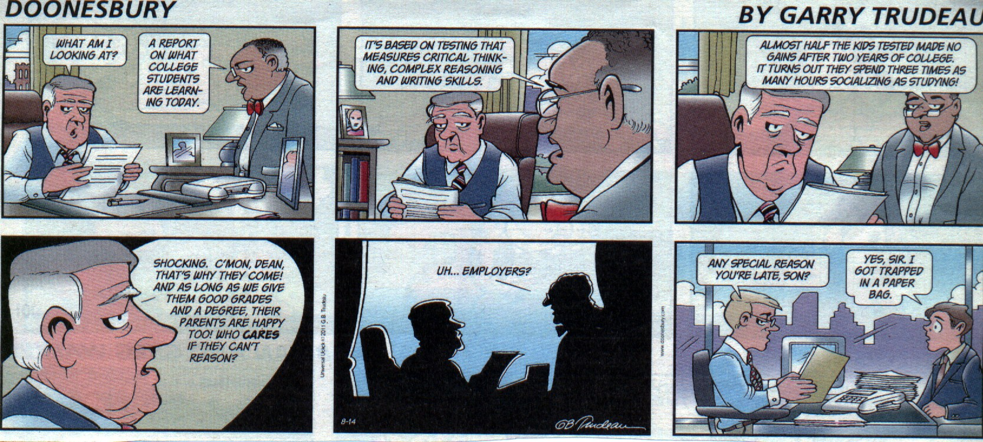
Critical Thinking Humor
85% of success of an engineering
graduate is based on soft skills,
not technical knowledge – recent ABET reviewer comment

Slide 9
What is critical thinking?
Reasoned, purposive, and reflective thinking used to make decisions, solve problems, and master concepts.
Rudd, 2002
We should be teaching students how to think, rather than what to think.
Tao, 2008

Slide 10
Good Critical Thinking allows you to:
Ask good questions
Develop convincing, persuasive answers to questions
Develop clear, purposeful actions/plans based on reasoning
Develop abilities to persuade others to ‘buy in’ to actions/plans
Be successful in whatever you choose to do in your career/life

Slide 11
Why Critical Thinking?
“Everyone agrees that students learn in college, but whether they learn to think is more controversial.”
McKeachie cited in Joscelyn, 1988
To be competitive in a global environment, BFPE engineering students need to distinguish themselves by being able to reason clearly and creatively develop solutions to global challenges.

Slide 12
Significance of Critical Arguments
Explaining why we behave the way we do, i.e. choices, actions
Persuade others to change their behavior/decisions/choices
For engineers:
Translate technical knowledge/information into social/business context to make decisions, have impact, enable change/improvement

Slide 13
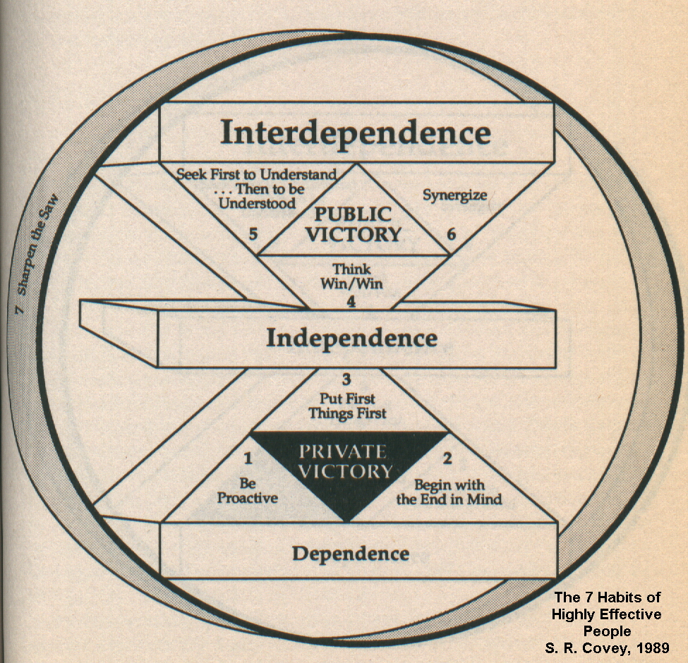
Attributes of a Successful Engineer
Knowledge
Technical knowledge is not enough to succeed today in global competition
Must be able to persuade/convince others to ‘buy in’ to plans/actions
Skills
Desire
85% of success of an engineering
graduate is based on soft skills,
not technical knowledge
Therefore, to be successful, engineering graduates
should learn critical thinking/arguments

Slide 14
Critical argument structure
A set of premises that logically leads to a conclusion which requires an action, decision, or specific behavior
A strong critical argument is one that compels a rational person to agree/obey its conclusion

Slide 15
Strength of a critical argument
Premises are objective/accurate/true (called soundness)
Pure water boils at 212 deg. F at 1 atm pressure (objective)
Men are attracted to thin women (subjective)
Conclusion logically results from premises (called validity)
A strong, compelling argument is one in which its premises are sound and its logic is valid.
See https://en.wikipedia.org/wiki/Logic

Slide 16
Critical Arguments answer the important question of WHY?
Why should you get a promotion/raise?
Why must food beyond its expiration date be removed from sale in the U.S.?
Why is it acceptable to have an average of 150 insect fragments per 100 grams of flour?
Why are you in ABE at Purdue?
Why should company X give you an internship?
Why should Dr. Tao give you a high grade in ABE 301?

Slide 17
Example
Premises:
Antibiotics kill active pathogenic bacteria.
The presence of active pathogenic bacteria in people makes them ill.
People do not wish to be ill.
(people should act in ways to fulfill their wishes)
Conclusion:
Therefore, people who are ill should take antibiotics.
Note specifically the use of the word “should” in a conclusion, which is used to require/indicate an action or change in behavior.

Slide 18
Heap of sand
Suppose that we dumped a pile of 100 million grains of sand on the sidewalk. This would be quite a significant heap of sand.
Now remove the sand, one grain at a time. At what point would we no longer have a heap?
It seems as though when we started we clearly did have a heap of sand, and by the time we got almost to the completion of the task, we clearly did not.
At question is when is a heap not a heap? (This is generically known as the Sorites' Paradox.)

Slide 19
HOS
(1) How might a technical person, such as an engineer or scientist normally answer to this kind of question? Would the answer be different for a non-technical person, such as an artist, historian, economist, or musician?
(2) Is there indeed a correct value of n (number of grains of sand in a heap) or is there no satisfactory answer?
(3) What, if anything, is the source of the apparent problem? What, if anything, does this example suggest about our ability to categorize, and to think precisely?
(4) Are there analogous problems facing engineers, scientists, or other technical disciplines in society? How about non-technical disciplines, such as politician, lawyers, civil rights activists, and medical professionals?
(5) Many engineering students state that they would eventually like to become corporate managers or decision makers in a company. To be successful, you must determine a course of action and then garner support and participation from all these people. What kinds of skills would you need and how might you accomplish this? How is this different for a graduates of different disciplines (e.g. engineering, history, medicine, law, music, etc.)?
WORDS are vague.

Slide 20
Critical argument structure: Premises
The accuracy/truthfulness of a premise is called soundness. Part of the analysis of the strength of an argument depends on the soundness of its premises. There are several types of premises.

Slide 21
Inductive vs. Deductive Premises
Inductive (specific observations -> generalization; based on specific observations/specific to general)
Every apple I have ever seen has been red.
There are apples at the grocery store.
Therefore, the apples at the grocery store must be red
Deductive (premises -> conclusion; based on definitions, principles/general to specific)
All rectangles have 4 sides.
A square has 4 sides.
Therefore, a square is a rectangle

Slide 22
Subjective vs. Objective Premises
An objective (or non-subjective) premise is one in which there is factual or generally agreed upon criteria for evaluating the soundness of the premise.
Examples:
A mile is greater than a meter in length.
Purdue’s ABE program is #1 in the country.
A subjective premise is one in which there are not agreed upon criteria for evaluating its soundness.
Examples:
Green is the best color.
Biological engineering is better than chemical engineering.

Slide 23
Critical argument structure: Logic Format
Logic format involves a sequence of statements which use the concept of equivalence/relationship between ideas/concepts. The ideas/concepts can be expressed by many different types (e.g. words, numbers, pictures, sounds, etc.) For example, consider the statements:
Premise 1. Men are mammals.
Premise 2. John is a man.
Conclusion: Therefore, John is a mammal.
If we replace the concepts of “men”, “mammal”, and “John” by the letters A, B, and C respectively, the statements become:
Premise 1. A are B.
Premise 2. C is a B.
Conclusion: Again, the resulting logical conclusion is C must be the same as A.
If we express these concepts as numbers, using a mathematical symbol, ‘=’ to replace the words “is” and “are”,
Premise 1. A=B
Premise 2. C=B
Conclusion: C=A.

Slide 24
Logical fallacies
Premise 1. Women are mammals.
Premise 2. John is a mammal.
Conclusion: Therefore, John is a woman.
This critical argument has the same logical structure as previously. However, the conclusion is not correct/strong.
Why?

Slide 25
Logical Fallacies
A fallacy is an error in reasoning/logic.
Types of fallacies
Deductive
Inductive
Circular reasoning
Causual
Equivocation

Slide 26
Deductive Fallacies in logic
Premise 1. Apples fall from trees onto the ground.
Premise 2. I observe an apple on the ground.
Conclusion: Therefore, the apple must have fallen from a tree.
Consequential fallacy – deductive assumption that if A occurs and B results, if B exists then A must have occurred
(Cause-effect)

Slide 27
Fallacy
Premise 1. Kangaroos have a pouch.
Premise 2. Kangaroos are mammals.
Premise 3. Bob is a mammal.
Conclusion: Therefore, Bob must have a pouch.
Composition fallacy – assumption that something true of a part must be true of the whole

Slide 28
Inductive Fallacies
Premise 1. It usually rains in the evening.
Premise 2. It is evening.
Conclusion: Therefore, it will rain.
Probability fallacy – inductive assumption that since something could occur, it is inevitable that it will occur

Slide 29
Circular reasoning/begging the question fallacies
Premises that are basically the same as the conclusion
Premise 1: The best colors are the ones I like.
Premise 2: I like the color green.
Premise 3: Green plants and leaves provide shade on hot, sunny days.
Premise 4: Green is soothing on the eyes.
Conclusion: Therefore, green is the best color.

Slide 30
Causual fallacies
Assume cause-effect relationships based on temporal sequence or proximity of events.
Premise 1: My computer broke yesterday.
Premise 2: I did not turn in my homework today.
Conclusion: I did not turn in my homework today because my computer broke yesterday.
Premise 1: Crime on campus has risen since last year.
Premise 2: There are more left-handed students on campus this year than last year.
Conclusion: Left-handed students are criminals.

Slide 31
Equivocation
Defining words as equal to make an argument
Premise 1: Murder is depriving a living entity of life.
Premise 2: Washing your hands kills bacteria.
Premise 3: Killing is the action of depriving a living entity of life.
Conclusion: Washing your hands is murder.

Slide 32
Fallacy
Premise 1. Joan is an “A” student.
Premise 2. “A” students do not receive “C” grades
Conclusion: Joan should not get a “C” grade in ABE 301
Circular fallacy – assumption that the consequence is the cause of a phenomenon

Slide 33
Analysis of Critical Arguments
Analysis of a critical argument means to evaluate whether its conclusion is rationally compelling/persuasive. The analysis process involves determining whether the premises of the argument are accurate/true (sound) and whether the conclusion is logically derived from the premises (valid).
Analysis generally involves:
Identify premises/conclusion of a critical argument
Examining premises to determining if they are accurate and objective and if not, to what extent they are subjective or inaccurate.
Examining the logic used to derive the conclusion to determine whether it is deductive or inductive and whether any logical fallacies exist.

Slide 34
Critical Analysis
Are the terms/words clearly understood/defined by the audience? (Any HOS?)
Are the premises based on fact or opinion? Are they true for all situations/communities or just for limited situations?
Is there a clear, logical progression from the premises to the conclusion? Are there any terms/words in the conclusion that are not in the premises? Are there any logical fallacies?

Slide 35
Evaluate this Critical Argument
Premise 1. Leah worked very hard in ABE 301.
Premise 2. Leah turned in every assignment on time in ABE 301.
Premise 3. Working very hard and turning in every assignment on time in a course are required to get a good grade.
Conclusion:
Therefore, Leah should get a good grade in ABE 301.

Slide 36
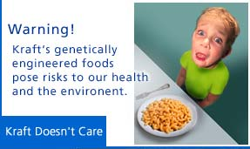
A visual critical argument
Looking at the image and analyze the argument being made.
Identify the conclusion
Identify the premises
Premises:
Kraft makes genetically engineered foods.
Eating/purchasing genetically engineered foods pose risks to our health and the environment.
Eating/purchasing foods that pose risks to our health and environment are bad actions.
Kraft macaroni and cheese contains genetically engineered foods.
Children are frightened by Kraft macaroni and cheese (picture).
Kraft does not care about posing risks to our health and the environment or about frightening children.
Purchasing/eating foods that frighten children is a bad action.
(We should not act badly.)
Therefore, we should not eat or purchase food from Kraft.

Slide 37
Synthesis of a Critical Argument
Creating a critical argument is generally much more difficult than analyzing a pre-existing argument.
The primary synthesis skills involve:
The ability to clearly, objectively state the premises and the ideas/concepts contained in the premises (soundness). This involves a good command of the medium used express the ideas, e.g. writing, creating images, sounds, etc.
The ability to construct valid logical relationships between the premises and the conclusion.

Slide 38
Develop an argument
Conclusion
Therefore, British Petroleum (BP) should not pay to clean up the gulf oil spill.
Premises
The purpose of business is to maximize making a profit.
Paying to clean up the gulf oil spill is an expense.
Paying to clean up the gulf oil spill does not produce income.
Profit equals income - expenses.
(Businesses should act in ways to fulfill their purpose.)
(BP is a business)
.

Slide 39
Synthesis of Critical Arguments
Desired conclusion: Dr. Tao should give all ABE 301 students a grade of A.
Premises:
Having better job opportunities is beneficial for students.
Students with high grades have better job opportunities.
A grade of ‘A’ is a high grade.
One of Dr. Tao’s actions is to give students grades in ABE 301.
(Dr. Tao’s actions should benefit students.)
Conclusion:
Therefore, Dr. Tao should give all ABE 301 students a grade of A.

Slide 40
Parallel logic/arguments
If the logic of a critical argument is valid, it should be able to be used in a parallel argument and still be valid.
Premise 1. A=B
Premise 2. C=B
Conclusion: C=A.
Premise 1. Women are mammals.
Premise 2. John is a mammal.
Conclusion: Therefore, John is a woman.
Note, however, the strength of the conclusion also depends on the
soundness of the premises. Note HOS issues and fallacies.

Slide 41
Purpose
When you are a professional manager and want to 1) make a decision/action, i.e. what project to fund, how to convince boss to give you a raise, whether to take a promotion, etc.
Use critical thinking/analysis skills to develop/analyze arguments to persuade or evaluate

Slide 42
Social/political/technical context
The recent changes in Egyptian government involve the army ousting the democratically elected theocratic (Islamic-based) government.
Does the U.S. Declaration of Independence justify/support taking action to support this change?
If so, would you expect these Arab countries to live harmoniously with western democracies such as Europe and the U.S.? Why or why not?
How might this impact your life/career in food/bioengineering?
If you were CEO of a large multinational food/pharma company, how would you manage doing business in countries who disagree about the format of government?
Would you allow transfer of research/technical information in food/pharma between such countries?

Slide 43
Arguments vs. Models: Parallel structure
Knowledge
Inductive/deductive
Premises
Accuracy/truth
HOS
Conclusion
Logical construction
Behavioral change/decision
Knowledge
Theory/observation
Assumptions
Accuracy/precision
Definitions
Model
Logical construction (mathematical)
Application/Utility decision
Same critical analysis/thinking skills needed for both

Slide 44
Differences/Similarities
Same critical analysis/thinking skills needed
Premises/assumptions
Logical construction to conclusion/model
Different knowledge set (maybe)
science/mathematics vs. political/economic
Behavioral biology/biological engineering (!)
Quantitative/deductive vs. qualitative/inductive
mathematics vs. experience/culture
Same outcomes (maybe)
Both used to make decisions, change behavior
Process of argument/model improvement
Issue of reproducibility in different situations

